Slide 1
System design and architecture
UNIT 5

Slide 2
5.1 Transition from Requirements to Design
Custom development vs packaged software vs outsourcing.
Developing system acquisition strategies based on business needs.
5.2 System Architecture Design
Designing client-server architectures and multi-tiered systems.
Introduction to cloud architecture and its relevance to modern system design.
Operational, performance, and security considerations in architecture design.
5.3 User Interface Design
Principles for effective UI design: Layout, aesthetics, consistency, and usability.
Prototyping and evaluating user interfaces.

Slide 3
System design and architecture
System design and architecture refer to the conceptual blueprint and structural organization of a software or hardware system.
They define how various components of a system interact, how they fulfill specific requirements, and how they meet performance, scalability, reliability, and maintainability goals.

Slide 4
System Design
System design focuses on creating solutions to address high-level requirements. It involves defining the structure, behavior, and interaction of components within a system.
Key Aspects:
High-Level Design (HLD):
Overview of the architecture.
Identifies major modules and components.
Defines communication protocols and data flow.
Examples: Client-server architecture, database schema.
Low-Level Design (LLD):
Detailed specifications for each component.
Includes algorithms, data structures, and module logic.
Provides a blueprint for developers.

Slide 5
System Architecture
System architecture defines the overall structure and behavior of the system at a higher level.
It ensures that the system aligns with business and technical goals.
Architectural Styles:
Monolithic Architecture:
All components are part of a single unit.
Simple but harder to scale.
Examples: Legacy applications.
Microservices Architecture:
Modular and independently deployable services.
Promotes scalability and fault isolation.
Examples: Netflix, Amazon.
Event-Driven Architecture:
Reacts to events (triggers and actions).
Asynchronous and scalable.
Examples: IoT systems, banking alerts.
Serverless Architecture:
Uses managed services for backend logic.
Reduces server management overhead.
Examples: AWS Lambda, Azure Functions.

Slide 6
Custom software development, packaged software, and outsourcing are all ways to develop or acquire software.
The best option depends on your business needs, budget, and time constraints.
Custom software development
What it is
Custom software is designed to meet a business's unique needs.
It can be developed in-house or by a development agency.
Custom software is a specific program that are advanced for a goal in a department or in a company.
It’s cost is higher than package software because custom software are made for a specific purpose.
Unlike package software, custom software can be modified or changed if there is need because these software are custom-built.

Slide 7
Benefits
Custom software can improve efficiency, scalability, and competitiveness.
It can also be a strategic investment that pays off over time.
Drawbacks
Custom software can be expensive and time-consuming to develop.
It may also require more training for users.
The best example of custom software is that a company that wishes to own a management system for their employees and keeping track of their working hours.

Slide 8
Examples of Custom Software Development
Example 1: CRM for a Real Estate Company
A real estate firm may need a Customer Relationship Management (CRM) system that tracks property listings, buyer interactions, and personalized recommendations.
Off-the-shelf CRM solutions might lack the depth required for industry-specific features, such as automatic match-making of buyers to listings.
Example 2: E-Commerce Platform
An e-commerce startup requires a unique platform to offer custom pricing, loyalty programs, and payment methods that differ from existing platforms like Shopify or WooCommerce.
A custom e-commerce site enables precise branding and tailored functionality.
Example 3: Healthcare Management System
A hospital might develop software to manage patient records, appointments, and inventory, while complying with legal regulations like HIPAA.
Customization ensures the system addresses specific healthcare workflows and data privacy requirements.

Slide 9
What is Packaged Software?
Packaged software is a collection of commercial applications that can be purchased for a set price.
Packaged software that is often called software package is a commercial program that’s obtainable to the general public and sold to them at explicit costs.
Package software is developed by computer technicians.
It is the compilation of programs which are grouped together in order to provide publicly with different tools in the same group.
It can’t be modified or altered even if there is need.
The essential definition says that, once several software package are grouped during a bundle and supply solutions to people, then it gets the specified name.
The best example of package software is Microsoft Office, that has many tools grouped together for example Office, Access, Excel, Note and Power Point.

Slide 10
Packaged software
Benefits
Packaged software can be cheaper and faster to implement than custom software.
It can also be a good option for businesses with standard needs.
Drawbacks
Packaged software may have fixed features and may not be flexible enough for businesses with evolving needs.

Slide 11
Outsourcing Software
Outsourcing software development involves hiring a third party to develop the software for you.
Outsourcing software development is the practice of hiring external organizations or teams to handle the design, development, testing, or maintenance of software projects.
This strategy allows businesses to focus on their core competencies while leveraging the expertise of specialized developers.
Benefits
Outsourcing can save money on labor, operations, and overhead costs.
It can also be less costly than hiring an in-house team.

Slide 12
Examples of Outsourcing Software Development
Example 1: Mobile App Development
A retail business hires an outsourcing company to develop a mobile app for e-commerce, including features like payment integration, user authentication, and inventory management.
Example 2: Software Modernization
A healthcare provider outsources the modernization of a legacy patient management system to a third-party team specializing in healthcare IT solutions.
Example 3: Startups Scaling Quickly
A startup with limited technical resources outsources the development of its Minimum Viable Product (MVP) to get to market faster

Slide 13
Advantages of Outsourcing Software Development
1. Cost Savings
Reduces costs associated with hiring, training, and maintaining in-house developers.
Often cheaper to outsource to countries with lower labor costs.
2. Access to a Global Talent Pool
Provides access to skilled professionals and specialists who may not be locally available.
Enables businesses to find developers with niche expertise.
3. Focus on Core Business
Allows organizations to concentrate on their core operations while leaving software development to experts.
4. Faster Time-to-Market
Dedicated outsourcing teams can accelerate development timelines.
Helps businesses launch products faster and stay competitive.

Slide 14
Disadvantages to Consider
Communication Barriers:
Differences in time zones, language, or cultural understanding can affect collaboration.
Quality Concerns:
Without proper vetting, quality may not meet expectations.
Security Risks:
Sharing sensitive information with an external team poses data security challenges.
Dependency:
Over-reliance on a single outsourcing partner can become a risk if issues arise.

Slide 15
Comparison Between Packaged Software, Custom Software, and Outsourcing Software
Aspect | Packaged Software | Custom Software | Outsourcing Software Development
Definition | Pre-built, ready-to-use software designed for general use by a broad audience. | Tailored software developed specifically to meet the unique needs of a business or individual. | Delegating software development tasks to an external team or organization.
Development Process | Already developed and available for purchase; no customization. | Developed from scratch based on specific business requirements. | External teams or firms handle the design, development, or maintenance of software.
Customization | Limited or no customization options. | Fully customizable to meet unique requirements. | Customization depends on the outsourcing agreement and project needs.
Cost | Usually cheaper upfront but may include recurring licensing fees. | Higher initial cost due to custom development but no recurring licensing fees. | Costs vary depending on the outsourcing model (onshore, offshore, nearshore).
Time to Implement | Quick, as it’s ready-made. | Longer, as it requires full development and testing. | Time depends on the outsourcing team’s efficiency and project scope.

Slide 16
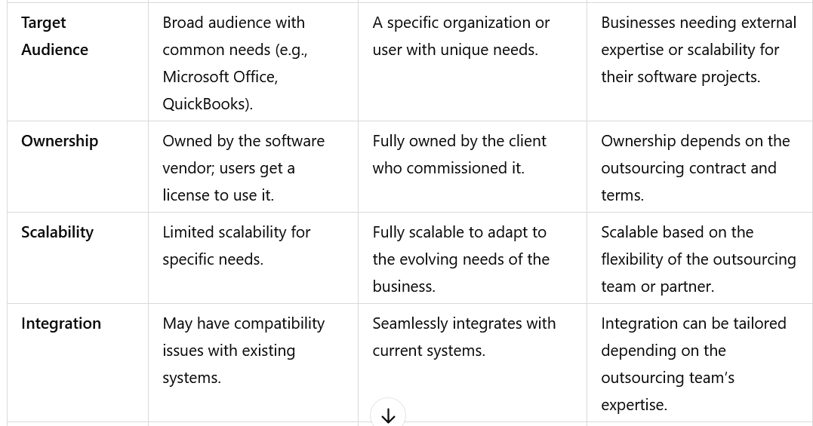

Slide 17
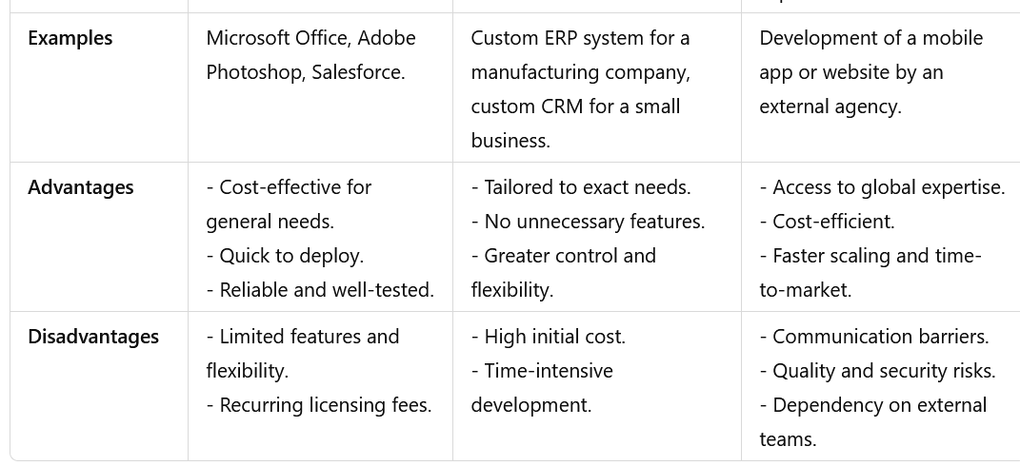

Slide 18
What are system acquisition strategies?
The acquisition strategy is an integrated plan that identifies the overall approach to rapidly and iteratively acquire, develop, deliver, and sustain software capabilities to meet the users' needs.

Slide 19
Developing system acquisition strategies based on business needs involves a systematic process to identify, evaluate, and implement systems that align with organizational goals.
Here are the key steps:
1. Understand Business Needs
Conduct stakeholder interviews to identify pain points and desired outcomes.
Analyze existing systems to determine gaps and inefficiencies.
Prioritize needs based on organizational goals, scalability, and budget.
2. Define Objectives and Requirements
Develop a clear set of functional and technical requirements.
Include performance metrics, integration needs, and compliance standards.
Establish a budget and timeline for acquisition.

Slide 20
3. Market Research and Vendor Evaluation
Research available solutions, including off-the-shelf, custom, or hybrid systems.
Request proposals (RFP) or quotes (RFQ) from vendors.
Evaluate vendors based on reliability, customer reviews, and long-term support.
4. Assessment and Feasibility Analysis
Conduct cost-benefit and ROI analysis for potential systems.
Evaluate technical compatibility and scalability with existing infrastructure.
Perform risk assessments, including potential implementation challenges.

Slide 21
5. Stakeholder Engagement
Involve key stakeholders to gain feedback on potential systems.
Ensure alignment with organizational culture and change management practices.
Communicate benefits and gather consensus to reduce resistance.
6. Pilot Testing and Evaluation
Implement a trial or pilot program to test the system in a controlled environment.
Gather performance data and user feedback during the trial.
Evaluate outcomes against pre-defined success metrics.

Slide 22
7. Decision and Acquisition
Select the system that meets the business needs most effectively.
Negotiate terms with the vendor, focusing on warranties, training, and support.
Finalize contracts and purchase agreements.
8. Implementation and Integration
Plan for system deployment, including training schedules and data migration.
Ensure integration with other business systems and processes.
Monitor progress and address issues promptly during the rollout.

Slide 23
9. Monitoring and Continuous Improvement
Establish KPIs to measure the system’s performance over time.
Solicit feedback from users to refine the system and address evolving needs.
Update the system as required to stay aligned with business objectives.
This process ensures that the selected system not only meets immediate requirements but also supports long-term growth and adaptability.

Slide 24
System architecture design
System architecture design is the process of defining the structure and behavior of a system.
It's a vital part of software engineering that serves as a blueprint for the system and project.
System Architecture design involves creating a blueprint for your system.
This blueprint defines the components, their interactions, and the technology stack to be used.

Slide 25
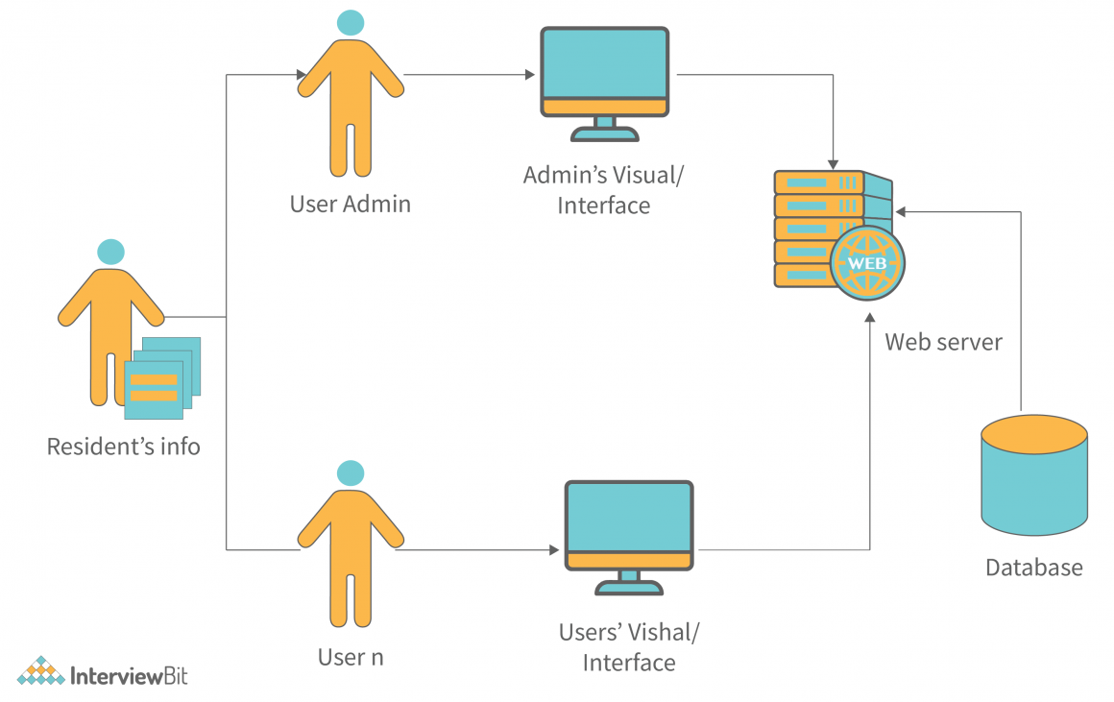
System architecture diagram
The system architecture diagram is a visual representation of the system architecture.
It shows the connections between the various components of the system and indicates what functions each component performs.
The general system representation shows the major functions of the system and the relationships between the various system components.

Slide 26
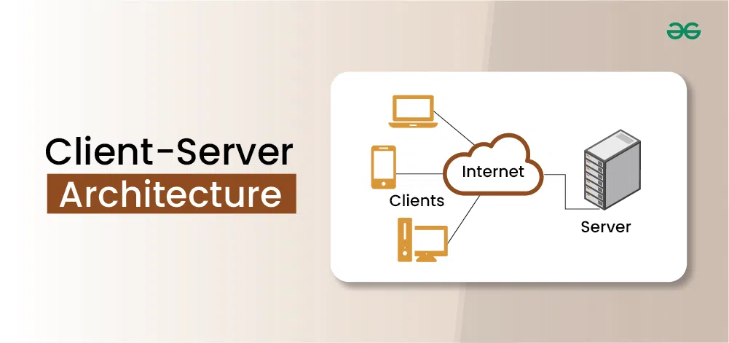
Client-server architecture
Client-server architecture is a fundamental concept in system design where a network involves multiple clients and a server.
Clients are devices or programs that request services or resources, while the server is a powerful machine providing these resources or services.
This architecture allows efficient data management and resource sharing, making it popular in web applications, databases, and other network-based systems.
By separating roles and distributing tasks, client-server architecture enhances performance, scalability, and security.

Slide 27
What is Client-Server Architecture?
Client-server architecture is a cornerstone of modern system design, where the network infrastructure is structured to include multiple clients and a central server.
In this model, clients are devices or programs that make requests for services or resources, while the server is a powerful machine or software that fulfills these requests.
Communication between clients and the server follows a request-response protocol, such as HTTP/HTTPS for web services or SQL for database queries.
This architecture allows for efficient data management and resource allocation by centralizing critical functions on the server, which can handle complex processing and large-scale data storage.
Clients manage user interactions and send specific requests to the server, which processes these requests and sends back appropriate responses.

Slide 28
The client-server architecture is highly scalable, as it can accommodate more clients by scaling the server's capabilities or adding additional servers.
This design is prevalent in various applications, including web services, database management, and email systems, providing a robust framework for developing and managing complex, distributed systems efficiently.

Slide 29
Key Components of Client Server Architecture
Client-server architecture in system design involves several key components that work together to ensure efficient communication, resource management, and service delivery.
Here are the main components:
Client: The client is a device or application that requests services or resources from the server.
Server: The server is a powerful machine or application that provides services or resources to clients.
Network: The network facilitates communication between clients and servers.
Protocols: Protocols are standardized rules that govern data transmission and communication between clients and servers.
Middleware: Middleware is software that acts as an intermediary between clients and servers.
Database: A database is a structured collection of data stored on the server. It stores and manages data that clients request, ensuring data consistency, integrity, and security.
User Interface (UI): The UI is the part of the client application that interacts with the user.
Application Logic: Application logic refers to the code and algorithms that define the application's functionality..

Slide 30
Design Principles for Effective Client-Server Architecture
Designing an effective client-server architecture involves several key principles that ensure the system is robust, scalable, secure, and efficient.
Here are the main design principles:
Modularity:
Separation of Concerns: Divide the system into distinct modules, such as the client, server, and database, each responsible for specific tasks. This separation simplifies development, testing, and maintenance.
Reusability: Design components that can be reused across different parts of the system or in different projects.
Scalability:
Horizontal Scalability: Ensure that the system can handle increased load by adding more servers or instances rather than just upgrading existing hardware.
Vertical Scalability: Allow for upgrades in server hardware, such as CPU, memory, and storage, to handle more intensive tasks.

Slide 31
Reliability and Availability:
Redundancy: Implement redundant components, such as multiple servers, to ensure the system remains operational in case of failures.
Load Balancing: Distribute client requests across multiple servers to prevent any single server from becoming a bottleneck.
Performance Optimization:
Efficient Communication: Optimize the communication protocols and data exchange formats to reduce latency and bandwidth usage.
Caching: Use caching mechanisms to store frequently accessed data closer to the client to improve response times.

Slide 32
Security:
Authentication and Authorization: Ensure that only authorized clients and users can access the server and its resources.
Encryption: Use encryption protocols (e.g., SSL/TLS) to secure data transmission between clients and servers.
Regular Audits: Conduct regular security audits and updates to identify and address vulnerabilities.
Maintainability:
Clean Code: Write clear, well-documented, and maintainable code to simplify debugging and future enhancements.
Version Control: Use version control systems to manage changes in the codebase and coordinate among development teams.
Interoperability:
Standard Protocols: Use standard communication protocols (e.g., HTTP/HTTPS, REST, SOAP) to ensure compatibility between different clients and servers.
Platform Independence: Design the system to support multiple platforms and devices, allowing various clients to interact with the server.

Slide 33
Frameworks and Tools for Client-Server Development
Developing client-server applications involves various frameworks and tools that cater to both the client and server sides. Here are some commonly used frameworks and tools for client-server development:
1. Server-Side Frameworks
Node.js: A JavaScript runtime built on Chrome's V8 engine, ideal for building scalable network applications.
Express.js: A minimal and flexible Node.js web application framework that provides a robust set of features for web and mobile applications.
Django: A high-level Python web framework that encourages rapid development and clean, pragmatic design. Comes with a built-in ORM, admin interface, and authentication mechanisms.
Spring Boot: A Java-based framework that simplifies the development of new Spring applications. Provides embedded servers and simplifies dependency management.

Slide 34
2. Client-Side Frameworks
React: A JavaScript library for building user interfaces, maintained by Facebook. Allows for the creation of reusable UI components and provides a virtual DOM for efficient rendering.
Angular: A platform and framework for building single-page client applications using HTML and TypeScript. Developed and maintained by Google.
Vue.js: A progressive JavaScript framework for building user interfaces. Designed to be incrementally adoptable, with a core library focused on the view layer.
Svelte: A radical new approach to building user interfaces, shifting much of the work to compile time. Produces highly optimized vanilla JavaScript at build time.
Bootstrap: A popular front-end framework for developing responsive and mobile-first websites. Provides pre-designed components and utilities.

Slide 35
3.Database Management Systems
MySQL: An open-source relational database management system. Widely used for web applications and known for its reliability and ease of use.
PostgreSQL: An advanced open-source relational database system. Known for its robustness, extensibility, and standards compliance.
MongoDB: A NoSQL database that uses a flexible, JSON-like document model. Ideal for applications requiring high performance, scalability, and flexibility in data structure.
SQLite: A self-contained, serverless, and zero-configuration SQL database engine. Suitable for embedded systems and small applications.
4. Communication Protocols and APIs
REST: Representational State Transfer, an architectural style for designing networked applications. Uses standard HTTP methods and is stateless.
GraphQL: A query language for APIs and a runtime for executing those queries. Allows clients to request exactly the data they need, reducing over-fetching.
WebSocket: A protocol providing full-duplex communication channels over a single TCP connection. Ideal for real-time applications like chat and gaming.

Slide 36
5. Development Tools
Postman: A collaboration platform for API development. Allows users to create, test, and document APIs.
Swagger: A suite of tools for API design and documentation. Provides an interface for developing and interacting with APIs.
Docker: A platform for developing, shipping, and running applications in containers. Ensures consistency across multiple development and production environments.
Kubernetes: An open-source system for automating deployment, scaling, and management of containerized applications. Provides powerful orchestration capabilities.
Git: A distributed version control system for tracking changes in source code during software development. Essential for collaborative development and maintaining code history.

Slide 37
What Are Multi-Tiered Systems?
A multi-tiered system is a software architecture design where the application is organized into separate layers (tiers) that serve distinct functions.
Each tier operates independently, but they work together to deliver the complete functionality of the system.
The separation of concerns enhances scalability, maintainability, and flexibility.

Slide 38
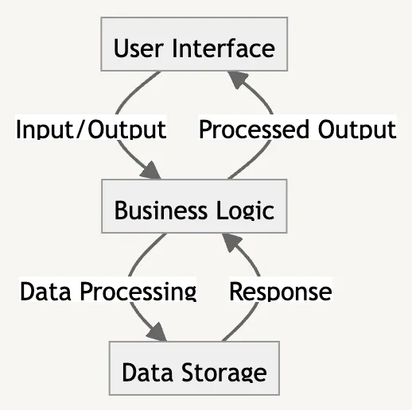
Multi-tier Architecture
1-Tier Architecture
1-Tier architecture, also known as single-layer or monolithic architecture.
It is a type of software architecture where all the components of an application — user interface, business logic, and data storage — reside in the same system or platform.
The user interface sends input to the business logic layer in this architecture.
The business logic layer processes the data, interacts with the storage layer, and returns the processed data to the user interface.

Slide 39
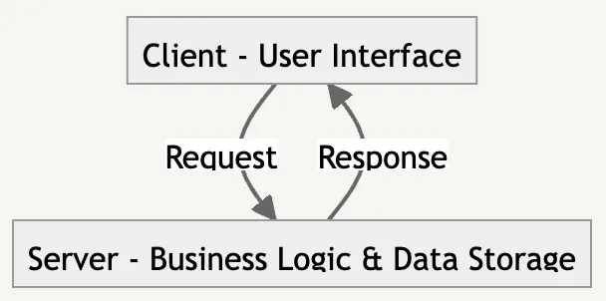
2-Tier Architecture
2-Tier architecture, or client-server architecture, divides an application into two main parts:
A client, typically the user interface, and
A server, encompassing the business logic and data storage layers.
In this model, the client sends requests to the server, where the business logic processes the request and interacts with the data storage.
The server then sends the response back to the client.

Slide 40
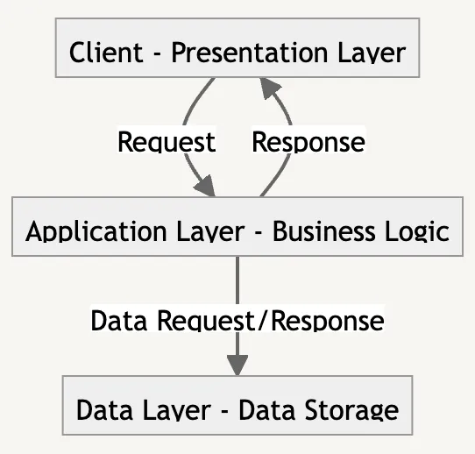
3-Tier Architecture
The 3-Tier architecture is a type of software architecture that separates an application into three logical tiers:
the presentation layer (client),
the application layer (business logic), and
the data layer (data storage and access).
In this architecture, the client sends a request to the application layer, which processes the request, interacts with the data layer, and sends the response back to the client.

Slide 41
Key Tiers in Multi-Tiered Systems
Typically, multi-tiered systems consist of three or more layers:
1. Presentation Tier (Client Layer):
Role: This is the user interface that interacts with the end user.
Responsibilities:
Collecting user input.
Displaying data and results.
Examples:
Web browsers.
Mobile applications.
Desktop GUIs.

Slide 42
2. Application Tier (Logic/Business Layer):
Role: The intermediary layer that processes data and implements the business logic.
Responsibilities:
Managing requests from the presentation tier.
Performing computations and applying rules.
Communicating with the data tier for data retrieval or updates.
Examples:
Backend servers running application logic.
APIs (Application Programming Interfaces).
Frameworks like Django, Spring Boot, or Express.js.

Slide 43
3. Data Tier (Database Layer):
Role: The storage layer where application data is managed.
Responsibilities:
Storing, retrieving, and updating data.
Ensuring data integrity and security.
Examples:
Relational databases (e.g., MySQL, PostgreSQL).
NoSQL databases (e.g., MongoDB, Cassandra).
Data warehouses.

Slide 44
Real-World Examples
E-Commerce Websites:
Presentation Tier: The website or app.
Application Tier: Business logic like calculating prices, applying discounts, or processing orders.
Data Tier: Databases storing products, user information, and order history.
Banking Systems:
Presentation Tier: Online banking portal.
Application Tier: Handles authentication, transaction validation, and notifications.
Data Tier: Stores customer accounts, balances, and transaction logs.

Slide 45
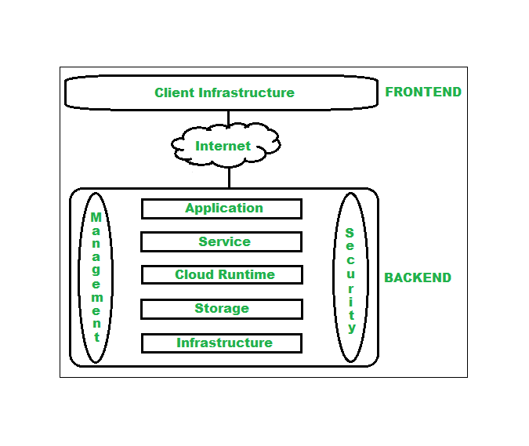
Cloud Computing Architecture
Architecture of cloud computing is the combination of both SOA (Service Oriented Architecture) and EDA (Event Driven Architecture).
Client infrastructure, application, service, runtime cloud, storage, infrastructure, management and security all these are the components of cloud computing architecture.
The cloud architecture is divided into 2 parts, i.e.
Frontend
Backend

Slide 46
1. Frontend
Frontend of the cloud architecture refers to the client side of cloud computing system.
Means it contains all the user interfaces and applications which are used by the client to access the cloud computing services/resources.
For example, use of a web browser to access the cloud platform.

Slide 47
2. Backend
Backend refers to the cloud itself which is used by the service provider.
It contains the resources as well as manages the resources and provides security mechanisms.
Along with this, it includes huge storage, virtual applications, virtual machines, traffic control mechanisms, deployment models, etc.

Slide 48
Components of Cloud Computing Architecture
Following are the components of Cloud Computing Architecture
Client Infrastructure – Client Infrastructure is a part of the frontend component. It contains the applications and user interfaces which are required to access the cloud platform. In other words, it provides a GUI( Graphical User Interface ) to interact with the cloud.
Application : Application is a part of backend component that refers to a software or platform to which client accesses. Means it provides the service in backend as per the client requirement.
Service: Service in backend refers to the major three types of cloud based services like SaaS, PaaS and IaaS. Also manages which type of service the user accesses.
Runtime Cloud: Runtime cloud in backend provides the execution and Runtime platform/environment to the Virtual machine.

Slide 49
Storage: Storage in backend provides flexible and scalable storage service and management of stored data.
Infrastructure: Cloud Infrastructure in backend refers to the hardware and software components of cloud like it includes servers, storage, network devices, virtualization software etc.
Management: Management in backend refers to management of backend components like application, service, runtime cloud, storage, infrastructure, and other security mechanisms etc.
Security: Security in backend refers to implementation of different security mechanisms in the backend for secure cloud resources, systems, files, and infrastructure to end-users.

Slide 50
Internet: Internet connection acts as the medium or a bridge between frontend and backend and establishes the interaction and communication between frontend and backend.
Database: Database in backend refers to provide database for storing structured data, such as SQL and NOSQL databases. Example of Databases services include Amazon RDS, Microsoft Azure SQL database and Google CLoud SQL.
Networking: Networking in backend services that provide networking infrastructure for application in the cloud, such as load balancing, DNS and virtual private networks.
Analytics: Analytics in backend service that provides analytics capabilities for data in the cloud, such as warehousing, business intelligence and machine learning.

Slide 51
Benefits of Cloud Computing Architecture
Makes overall cloud computing system simpler.
Improves data processing requirements.
Helps in providing high security.
Makes it more modularized.
Results in better disaster recovery.
Gives good user accessibility.
Reduces IT operating costs.
Provides high level reliability.
Scalability.

Slide 52
Cloud architecture Relevance to Modern System Design
Scalability:
Cloud architecture enables dynamic scaling of resources to meet varying workloads without over-provisioning.
Essential for applications with unpredictable traffic, such as e-commerce websites or video streaming platforms.
Cost-Effectiveness:
Organizations can avoid large capital expenses by adopting a pay-as-you-go model.
Reduces hardware and maintenance costs.
Flexibility and Accessibility:
Supports remote access and collaboration from any location, improving productivity.
Enables businesses to deploy multi-region applications effortlessly.

Slide 53
4. High Availability and Resilience:
Cloud architecture often includes redundant resources and failover mechanisms.
Ensures minimal downtime and improved reliability.
5. Rapid Innovation:
Cloud services provide ready-to-use tools for AI, machine learning, and big data analytics.
Reduces time-to-market for new products and services.
6. Global Reach:
Cloud providers offer data centers worldwide, allowing applications to serve users from multiple regions with low latency.

Slide 54
Example Applications in Modern Design
Netflix: Uses cloud architecture for content streaming and scalable infrastructure.
Online Collaboration Tools: Tools like Google Workspace rely on SaaS cloud models.
Healthcare Systems: Cloud-based EMR (Electronic Medical Records) and telehealth platforms.

Slide 55
Operational, Performance, and Security Considerations in Architecture Design
When designing a system architecture, it is crucial to balance operational efficiency, performance optimization, and robust security.
These considerations ensure the architecture is reliable, scalable, and protected against potential threats while delivering high-quality user experiences.

Slide 56
Operational Considerations
Operational considerations focus on the system's efficiency, maintainability, and reliability during its lifecycle.
Scalability:
Ensure the architecture can handle increased workloads by scaling horizontally (adding more instances) or vertically (upgrading resources).
Use load balancers to distribute traffic efficiently.
Availability and Redundancy:
Design for high availability (HA) using failover systems, clustered resources, and geo-redundant deployments.
Implement monitoring tools to detect outages and trigger automated recovery mechanisms.
Maintainability:
Ensure modular design to simplify updates, debugging, and system changes.
Use Infrastructure-as-Code (IaC) tools like Terraform or AWS CloudFormation for consistent deployments.
Automation:
Automate deployment pipelines with CI/CD (Continuous Integration/Continuous Deployment) practices.
Use orchestration tools like Kubernetes to manage containerized applications efficiently.
Monitoring and Logging:
Employ tools like Prometheus, Grafana, or ELK Stack for real-time performance and error monitoring.
Set up alert systems for proactive issue resolution.

Slide 57
Performance Considerations
Performance considerations aim to optimize speed, responsiveness, and resource utilization.
Latency and Response Time:
Use caching mechanisms (e.g., Redis, Memcached) to reduce latency.
Optimize database queries and reduce bottlenecks using indexing or sharding.
Load Balancing:
Distribute workloads evenly across servers using hardware or software load balancers.
Consider global load balancers for multi-region architectures.
Resource Utilization:
Optimize CPU, memory, and storage usage to prevent resource exhaustion.
Use autoscaling to allocate resources dynamically based on demand.
Concurrency:
Support simultaneous users by designing for thread-safe operations and concurrent processing.
Use frameworks and languages optimized for concurrency (e.g., Node.js, Go).
Testing and Optimization:
Perform regular load, stress, and performance tests.
Profile applications to identify bottlenecks and optimize code or infrastructure.

Slide 58
Security Considerations
Security considerations protect data, systems, and users from potential threats and vulnerabilities.
Data Security:
Encrypt data in transit (e.g., TLS/SSL) and at rest (e.g., AES-256).
Implement robust key management practices.
Access Control:
Enforce least privilege principles using role-based access control (RBAC) or attribute-based access control (ABAC).
Use identity and access management (IAM) systems for authentication and authorization.
Network Security:
Design secure network perimeters with firewalls, virtual private networks (VPNs), and network segmentation.
Use intrusion detection and prevention systems (IDS/IPS).
Application Security:
Secure APIs using authentication tokens (e.g., OAuth, JWT).
Regularly test applications for vulnerabilities (e.g., SQL injection, cross-site scripting).
Threat Detection and Response:
Set up real-time threat monitoring tools like SIEM (Security Information and Event Management) systems.
Implement incident response plans to address breaches quickly.

Slide 59
Principal for effective UI design :Layout ,aesthetics ,consistency ,usability
UI/UX plays a vital role for websites or any other digital product as it directly impacts user interaction and engagement.
UI and UX are two different but interrelated concepts in the design of a web page or a digital product.
In simple words, UI is like a visible part of a product and UX is the concept behind it.

Slide 60
What is UI Design?
UI (User interface) Design is the interface of the website or a digital product through which a user interacts.
The main goal of UI is to catch and grab user attention by making the user interface look more pleasing and aesthetic.
Nowadays UI is very important for any organization to scale up because there are lots of businesses offering similar products or services in the market are available.
So there is tough competition between brands, one takes the edge over another having a great UI.

Slide 61
Importance of UI Design
User Interface (UI) design plays an important role in the success of a website or a digital product for the following reasons:
User Experience: A well designed UI can make customers to navigate easily and complete their tasks which leads to positive user experience.
Engagement: A good UI can make users stay on the platform or make them visit more often.
Branding: UI communicates the product's personality and features to the users, so visually appealing UI can make brands recognizable by the users.
Efficiency: A well designed UI can reduce time and efforts which increases user efficiency which leads to user satisfaction.

Slide 62
Principal for effective UI design :Layout ,aesthetics ,consistency ,usability
1. Layout
The layout is the arrangement of visual elements on the interface.
Principles:
Hierarchy: Organize content to highlight the most important elements (e.g., titles, buttons). Use size, color, and placement to establish this.
Alignment: Ensure elements are aligned for a clean, structured appearance. Grid systems help achieve this.
Spacing: Use whitespace effectively to avoid clutter and make content more readable.
Grouping: Related elements should be grouped together to help users quickly understand the relationship between them.
Example:
A form layout should place labels close to their respective input fields, with proper spacing to avoid overwhelming the user.

Slide 63
2. Aesthetics
Aesthetics relate to the visual appeal of the design.
Principles:
Color Scheme: Choose harmonious colors that align with the purpose of the interface (e.g., soft tones for health apps, vibrant colors for entertainment).
Typography: Select readable fonts and maintain consistency in font sizes for headings, subheadings, and body text.
Imagery and Icons: Use high-quality visuals and intuitive icons that match the tone of the interface.
Balance: Ensure a visually balanced layout by distributing elements evenly across the screen.
Example:
A minimalist design with neutral tones and clean typography can make a finance app feel professional and trustworthy.

Slide 64
3. Consistency
Consistency ensures that users can navigate and interact with the interface intuitively.
Principles:
Visual Consistency: Use the same colors, fonts, and button styles throughout the interface.
Functional Consistency: Ensure similar actions lead to similar results across all sections (e.g., a back button always returns to the previous page).
Platform Standards: Follow platform-specific guidelines (e.g., Material Design for Android, Human Interface Guidelines for iOS).
Example:
If a button design for “Submit” is blue and rectangular, all similar actions like “Save” or “Update” should have the same style.

Slide 65
4. Usability
Usability ensures the interface is easy to use and accomplishes its intended purpose.
Principles:
Clarity: Make tasks straightforward and avoid jargon. Use familiar terms and symbols.
Feedback: Provide immediate feedback for user actions (e.g., a loading spinner or a success message after submitting a form).
Error Prevention and Recovery: Minimize the chances of errors and offer solutions when they occur (e.g., undo options or clear error messages).
Responsiveness: Ensure the interface adapts to different devices and screen sizes.
Example:
A shopping app should provide a confirmation message after adding an item to the cart and allow users to easily undo this action.

Slide 66
Prototyping and evaluating a user interface
Prototyping and evaluating a user interface" refers to the process of creating a mock-up version of a digital product's interface (the prototype) to test and gather feedback from users.
Allowing designers to identify potential usability issues and refine the design before fully developing the final product.
This involves creating a representative version of the interface, then observing users interacting with it to understand their experience and make improvements based on their feedback.
Key points about prototyping and evaluating a UI:
Purpose:
To identify usability issues early in the design process, optimize user experience, and minimize the need for costly redesigns later on

Slide 67
Prototyping
Prototyping involves creating an early model of the user interface to visualize and test its functionality.
Types of Prototypes
Low-Fidelity Prototypes:
Are simple and rough representations of a user interface.
They focus on the structure, layout, and functionality of the interface without delving into detailed design elements like colors, typography, or interactivity.
Simple sketches or wireframes.
Focus on layout and basic structure.
Tools: Pen and paper, Figma, Balsamiq.
Example Use Case:
Creating a wireframe for a mobile app's login screen to determine where the username,
password fields, and login button should be placed, without worrying about colors or fonts.

Slide 68
High-Fidelity Prototypes:
High-Fidelity Prototypes are detailed and interactive representations of a user interface that closely resemble the final product.
They include realistic visuals, colors, typography, and often simulate actual interactions.
Detailed and interactive designs, closer to the final product.
Include visual design, animations, and functionality.
Tools: Adobe XD, Figma, Sketch, Axure.
Example Use Case:
A fully interactive design of an e-commerce app where users can browse products, add items to their cart, and proceed to checkout, all with accurate visuals and working navigation.

Slide 69
Steps in Prototyping
Define Objectives: Understand the user needs, tasks, and goals.
Create Wireframes: Draft rough layouts to represent the structure of the interface.
Build Interactive Prototypes: Add interactivity to simulate user interactions.
Test the Prototype: Use the prototype to gather feedback before moving to development.

Slide 70
Evaluating User Interfaces
Evaluation ensures the interface meets user needs and expectations.
Evaluation Methods
Heuristic Evaluation:
Heuristic Evaluation is a usability inspection method where experts evaluate a user interface against a set of predefined usability principles, known as heuristics.
It is a cost-effective way to identify usability issues early in the design process.
Experts assess the interface using usability heuristics (e.g., Nielsen’s 10 heuristics).
Focuses on issues like consistency, error prevention, and efficiency.
Key Characteristics of Heuristic Evaluation:
Principle-Based: Evaluators assess the interface using established heuristics, such as Jakob Nielsen’s 10 usability heuristics.
Expert Evaluation: Conducted by usability experts or designers familiar with the principles.
Early Detection: Identifies usability problems before involving end-users, saving time and resources.
Iterative Process: Often performed multiple times throughout the design process.

Slide 71
Jakob Nielsen’s 10 Usability Heuristics:
Visibility of System Status: The system should keep users informed about what is happening through feedback within a reasonable timeframe.
Match Between System and the Real World: Use language, symbols, and concepts familiar to users.
User Control and Freedom: Provide undo and redo options to allow users to correct errors.
Consistency and Standards: Follow platform conventions to avoid confusion.
Error Prevention: Design interfaces to prevent errors before they occur.
Recognition Rather Than Recall: Minimize users' memory load by making actions and options visible.
Flexibility and Efficiency of Use: Cater to both novice and experienced users, offering shortcuts for frequent tasks.
Aesthetic and Minimalist Design: Include only necessary information to avoid clutter.
Help Users Recognize, Diagnose, and Recover from Errors: Use clear error messages with solutions.
Help and Documentation: Provide help materials for users when needed.

Slide 72
Process of Heuristic Evaluation:
Plan the Evaluation:
Define the scope of the evaluation.
Select evaluators with expertise in usability.
Review Interface Independently:
Each evaluator examines the interface independently to avoid bias.
Identify and Document Issues:
Record usability issues along with the violated heuristic and severity.
Aggregate Findings:
Combine findings from all evaluators for a comprehensive view.
Prioritize Issues:
Rank issues by severity to guide design improvements.
Iterate on Design:
Address critical usability problems and repeat the evaluation if necessary.

Slide 73
2.User Testing:
Real users interact with the prototype to perform specific tasks.
Observers note usability issues, task completion rates, and user satisfaction.
User Testing is a usability evaluation method where real users interact with a product or prototype to identify issues, gather feedback, and ensure the design meets their needs and expectations.
It focuses on understanding how users experience the interface and completing tasks.
Key Characteristics of User Testing:
User-Centered: Conducted with actual or representative users of the product.
Task-Based: Participants perform specific tasks to assess the usability and functionality of the interface.
Feedback-Oriented: Observations, verbal feedback, and performance metrics are collected to identify issues.
Iterative: Conducted at multiple stages of development to refine the design.

Slide 74
Methods of User Testing:
Moderated Testing:
Facilitator guides users through tasks and observes in real-time.
Allows for immediate clarification and follow-up questions.
Unmoderated Testing:
Participants complete tasks independently, often remotely.
Tools like User Testing or Maze can record their interactions.
A/B Testing:
Users test two versions of the interface to determine which performs better.

Slide 75
A/B Testing, also known as split testing, is a method of comparing two or more versions of a design, feature, or interface to determine which one performs better based on user behavior.
It is commonly used in web design, marketing, and product development to optimize user experience and improve outcomes like conversion rates or engagement.
Key Characteristics of A/B Testing:
Controlled Experiment:
Two (or more) variations are shown to different groups of users simultaneously.
Users are randomly assigned to each group.
Data-Driven:
Performance is measured based on predefined metrics, such as click-through rate, conversion rate, or task completion time.
Iterative Process:
Results guide future design improvements or feature development.

Slide 76
How A/B Testing Works:
Identify the Goal:
Define the metric you want to optimize (e.g., increasing sign-ups, reducing bounce rate).
Create Variations:
Version A: The current design (control).
Version B: A new design or feature to test (variation).
Divide the Audience:
Randomly split users into groups. One group interacts with Version A, and the other with Version B.
Collect Data:
Track user behavior, such as clicks, purchases, or time spent on the page.
Analyze Results:
Compare performance metrics of both versions to determine the winner.
Use statistical methods to ensure the results are significant.
Implement the Best Version:
Roll out the higher-performing version to all users.

Slide 77
4.Surveys and Feedback:
Surveys and Feedback are methods used to gather direct input from users about their experiences, preferences, and opinions related to a product, service, or user interface.
These techniques help understand user needs, identify pain points, and collect insights to improve usability and overall satisfaction.
Surveys
Surveys are structured questionnaires designed to collect quantitative or qualitative data from users.
Types of Surveys:
Closed-Ended Surveys:
Use predefined options (e.g., multiple choice, scales, or ratings).
Example: "How would you rate your experience? (1 to 5)"
Suitable for statistical analysis.
Open-Ended Surveys:
Allow users to provide detailed, free-form answers.
Example: "What did you like most about this app?"
Useful for capturing insights and ideas.
Mixed Surveys:
Combine closed and open-ended questions for a balanced approach.

Slide 78
Survey Tools:
Google Forms, SurveyMonkey, Typeform, and Microsoft Forms.
When to Use Surveys:
After a usability test to gauge user satisfaction.
Post-launch to assess how well the product meets user needs.
To prioritize features or improvements based on user preferences.

Slide 79
5.Analytics and Metrics:
Analytics and Metrics refer to the processes and measurements used to track, analyze, and evaluate user behavior, performance, and outcomes on digital platforms.
These tools provide insights into how users interact with a product or service, enabling data-driven decisions to improve usability, functionality, and business goals.
Analytics
Analytics involves collecting and interpreting data about user behavior on a website, app, or system.
Key Features of Analytics:
Tracking User Interactions:
Measures clicks, navigation paths, time spent, and engagement.
Aggregating Data:
Combines individual user data to identify patterns and trends.
Providing Insights:
Helps understand what’s working and where users face challenges.
Common Analytics Tools:
Google Analytics: Tracks website traffic, user demographics, and behavior.
Hotjar: Provides heatmaps and session recordings to visualize user behavior.

Slide 80
Metrics
Metrics are specific, quantifiable measurements used to evaluate performance.
Types of Metrics:
User Behavior Metrics:
Page Views: Number of times a page is loaded.
Bounce Rate: Percentage of users who leave after viewing only one page.
Session Duration: Average time users spend on a site or app.
Click-Through Rate (CTR): Percentage of users who click on a specific element, like a button or link.
Engagement Metrics:
Daily Active Users (DAU): Number of unique users interacting daily.
Retention Rate: Percentage of users returning after their first visit.
Churn Rate: Percentage of users who stop using the product.
Conversion Metrics:
Conversion Rate: Percentage of users completing a desired action, like signing up or making a purchase.
Cart Abandonment Rate: Percentage of users who add items to their cart but do not complete the purchase.
Performance Metrics:
Load Time: How long it takes for a page or app to load.
Error Rate: Frequency of system errors or failures.

Slide 81
Example:
A company wants to optimize their e-commerce site.
Analytics: Tracks user paths from landing pages to checkouts.
Metrics:
Bounce Rate: High on the product page.
Conversion Rate: Low for mobile users.
Action: Improve mobile page design and add product descriptions to reduce bounce rate and increase conversions.

Slide 82
Steps for Effective Prototyping and Evaluation
Plan:
Identify the target users and key tasks.
Set clear goals for the prototype and evaluation.
Design the Prototype:
Choose the fidelity based on the stage of development.
Focus on core features and user flows.
Conduct Evaluation:
Test with a representative user group.
Observe and document usability issues and user feedback.
Iterate:
Refine the prototype based on evaluation results.
Repeat the process until usability goals are met.

Slide 83
Key Benefits
Detect usability issues early in the design process.
Improve user satisfaction by aligning the interface with user needs.
Save time and resources by reducing costly redesigns in later stages.

